Slide 1









Essential AWS Services
Comprehensive Overview of Core AWS Services
PRESENTED BY: SYED MUBEEN

Slide 2
AGENDA
AWS Lambda: Serverless Compute
AWS API Gateway: Fronting Your Services
AWS KMS: Secure Key Management
AWS SQS & Amazon MQ: Messaging & Queuing
AWS Secrets Manager: Centralized Credential Handling
AWS WAF: Protecting Your Web Applications
AWS Systems Manager Parameter Store: Configuration Management

Slide 3
AWS Lambda: Serverless Compute

Slide 4
AWS Lambda: Event-Driven Serverless Compute
Title: AWS Lambda: Event-Driven Serverless Compute
What it is: A serverless compute service that runs your code in response to events and automatically manages the underlying compute resources.
Purpose:
Run code without provisioning or managing servers.
Scale automatically and pay only for compute time consumed.
Build event-driven architectures.
Key Detail: "Functions as a Service" (FaaS) paradigm.

Slide 5
Lambda in Action: Events, Functions, & Runtimes
Event Source: Triggers the Lambda function (e.g., S3 upload, DynamoDB stream, API Gateway request, CloudWatch event).
Lambda Function: Your code written in a supported language (Python, Node.js, Java, Go, C#, Ruby).
Execution Environment: Isolated runtime environment created on demand.
Concurrency: Number of concurrent executions.
Cold Starts: Initial latency when a new execution environment is provisioned.

Slide 6
Customizing Lambda: Configuration Options
Memory: Configurable RAM (influences CPU and cost).
Timeout: Maximum execution duration.
Environment Variables: Pass configuration settings to your function.
VPC Connectivity: Connect functions to resources within your VPC.
Layers: Share code, libraries, and custom runtimes.
Dead-Letter Queues (DLQs): For failed asynchronous invocations.

Slide 7
Versatile Workloads: Where Lambda Shines
Web Applications: Backend for web/mobile apps (with API Gateway).
Data Processing: Real-time stream processing (Kinesis, DynamoDB Streams), S3 event processing.
Backend Automation: Scheduled tasks (CloudWatch Events), cron jobs.
IT Automation: Responding to operational events, infrastructure management.
IoT Backends: Processing data from IoT devices.

Slide 8
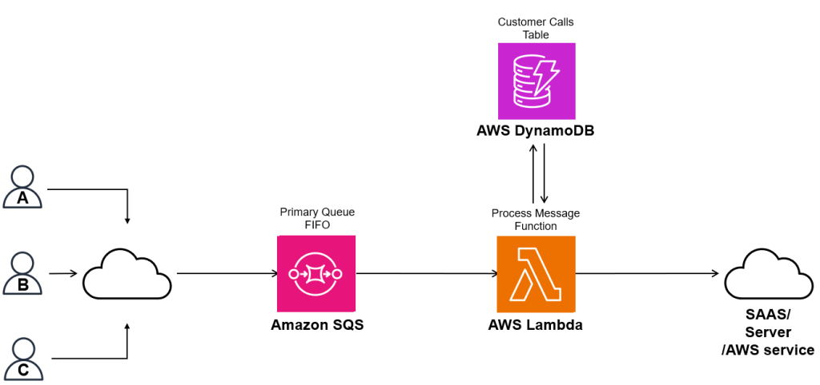
How Lambda Works & Key Concepts

Slide 9
Optimizing Lambda: Performance & Cost
Idempotency: Design functions to handle duplicate events gracefully.
Small, Single-Purpose Functions: Follow the single responsibility principle.
Logging & Monitoring: Use CloudWatch Logs/Metrics for visibility.
Cost Optimization: Monitor memory and execution duration; leverage Provisioned Concurrency for latency-sensitive applications.
Security: Grant least privilege IAM roles.

Slide 10
AWS API Gateway (Fronting Your Services)

Slide 11
AWS API Gateway: The Front Door to Your Applications
What it is: A fully managed service that makes it easy for developers to create, publish, maintain, monitor, and secure APIs at any scale.
Purpose:
Provide a unified API endpoint for various backend services (Lambda, EC2, HTTP endpoints).
Handle request routing, authentication, authorization, throttling, and caching.
Improve security and performance of APIs.
Key Detail: Acts as a "reverse proxy" for your APIs.
Suggested Image: API Gateway logo, a diagram with a gateway acting as a central hub.

Slide 12
Diverse APIs: REST, HTTP, and WebSocket
REST APIs: Build traditional HTTP APIs with full feature sets (request/response mapping, custom authorizers).
HTTP APIs: Optimized for low latency and cost-effectiveness, simpler features for common API use cases.
WebSocket APIs: Enable two-way communication for real-time applications (chat apps, dashboards).
Features: Request/Response Transformation, Caching, Throttling, Custom Domain Names, API Keys.

Slide 13
Securing & Observing Your APIs
Authentication & Authorization:
IAM roles/policies
Lambda Authorizers (Custom authorizers)
Cognito User Pools Authorizers
WAF Integration: Protect against common web exploits
SSL/TLS: Encrypted communication.
CloudWatch Integration: Logs, metrics, and alarms for API usage and performance.
Access Logs: Detailed logs of API requests.

Slide 14
Empowering Modern Application Architectures
Serverless Backends: Connect mobile/web apps to Lambda functions.
Microservices Orchestration: Aggregate multiple microservices into a single API.
Third-Party Integrations: Provide a clean API for partners or external consumers.
Real-time Applications: Power chat applications, live dashboards (with WebSocket APIs).

Slide 15
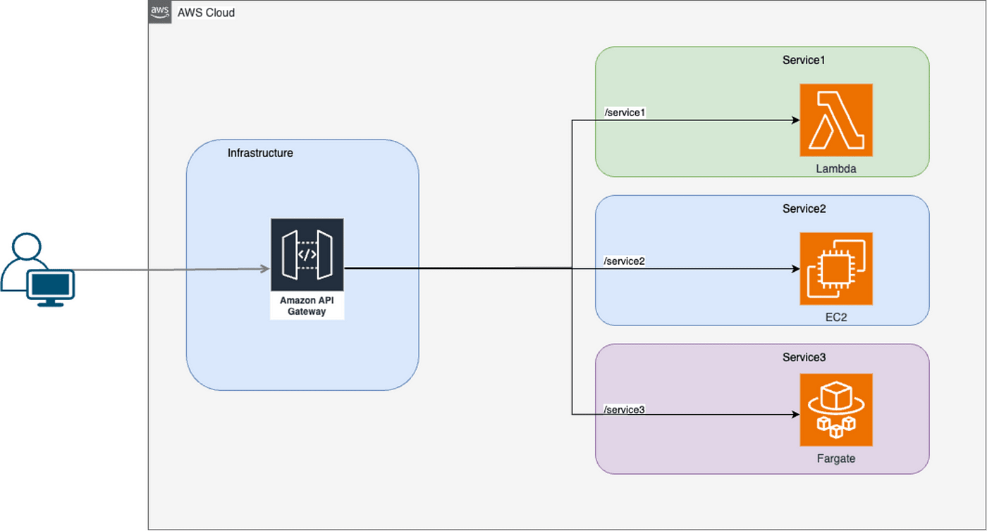
HOW API Gateway WORKS

Slide 16
Designing Robust & Scalable APIs
Versioning: Use stages or path segments for API versions.
Error Handling: Implement consistent error responses.
Caching Strategy: Optimize performance for static data.
Throttling Limits: Protect your backend services from overload.
Least Privilege: Ensure API Gateway's execution role has only necessary permissions.
Monitoring API Usage: Track performance and identify bottlenecks.

Slide 17
AWS KMS (Key Management Service)

Slide 18
AWS KMS: Centralized Cryptographic Key Management
What it is: A managed service that makes it easy for you to create and control the encryption keys used to encrypt your data.
Purpose:
Simplify the management of cryptographic keys at scale.
Integrate with other AWS services for data encryption at rest and in transit.
Provide audit trails for key usage.
Ensure compliance with regulatory requirements.
Key Detail: Highly integrated with almost all AWS services.

Slide 19
Understanding KMS Keys: CMKs, Data Keys & Envelope Encryption
Customer Master Keys (CMKs): Primary encryption keys managed by KMS.
Customer Managed CMKs: You create, own, and manage.
AWS Managed CMKs: AWS creates and manages on your behalf for specific services.
AWS Owned CMKs: AWS owns and manages for its own services.
Data Keys: Used to encrypt data directly; CMKs encrypt and decrypt Data Keys.
Envelope Encryption: Encrypting data with a Data Key, then encrypting the Data Key with a CMK.

Slide 20
Controlling Access: Key Policies & Grants
Key Policies: Define who can use a CMK and how (e.g., allow specific IAM users/roles to encrypt/decrypt).
IAM Policies: Can be used in conjunction with key policies to grant permissions.
Grants: Allow temporary or specific permissions to a CMK for a particular operation.

Slide 21
Pervasive Security: KMS Across AWS
S3 Encryption: Encrypt objects at rest (SSE-KMS).
EBS Encryption: Encrypt EC2 volumes.
RDS Encryption: Encrypt database instances.
Secrets Manager: Encrypts stored secrets.
Lambda Environment Variables: Can be encrypted using KMS.
Custom Application Encryption: Direct API calls to encrypt/decrypt data within your applications.

Slide 22
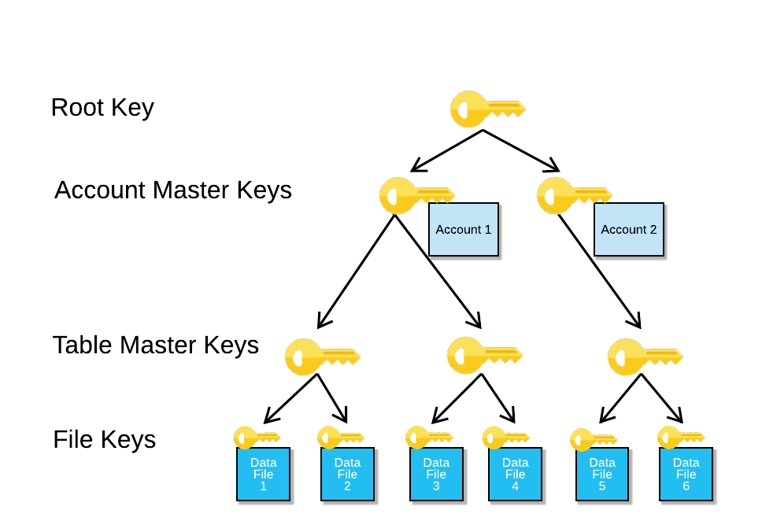
KMS Key Types & Hierarchy

Slide 23
Secure Key Management & Auditing
Principle of Least Privilege: Grant only necessary permissions to CMKs.
Key Rotation: Enable automatic rotation for customer-managed CMKs.
CloudTrail Integration: Audit all API calls made to KMS for compliance and security monitoring.
Multi-Region Keys: For disaster recovery and multi-region deployments.
Separation of Duties: Different roles for key administrators and key users.

Slide 24
AWS SQS & Amazon MQ (Messaging & Queuing)

Slide 25
Messaging & Queuing: Decoupling Applications
What it is (SQS): A fully managed message queuing service that enables you to decouple and scale microservices, distributed systems, and serverless applications.
What it is (Amazon MQ): A managed message broker service for Apache ActiveMQ and RabbitMQ, making it easy to set up and operate message brokers in the cloud.
Purpose:
Decoupling: Allow components to communicate without direct dependencies.
Scalability: Absorb spikes in traffic and process messages asynchronously.
Reliability: Store messages until they are processed successfully.
Key Detail: SQS is "queue as a service", Amazon MQ is "broker as a service".

Slide 26
SQS: Simple, Scalable, & Reliable Queues
Standard Queues:
High throughput, best-effort ordering, at-least-once delivery.
Almost unlimited throughput.
FIFO (First-In, First-Out) Queues:
Strict message ordering, exactly-once processing.
Lower throughput compared to Standard queues.
Features:
Visibility Timeout: Prevents multiple consumers from processing the same message.
Dead-Letter Queues (DLQs): For messages that cannot be processed successfully.
Message Retention: Configurable duration messages stay in the queue.
Long Polling: Reduces cost and increases efficiency by waiting for messages.

Slide 27
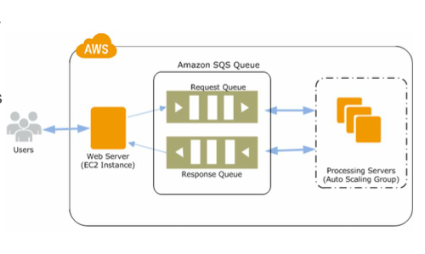
HOW AWS SQS WORKS

Slide 28
Amazon MQ: Managed Message Brokers
Managed Service: AWS handles provisioning, patching, backups, and monitoring.
Supports Open Standard APIs: Apache ActiveMQ and RabbitMQ.
Use Cases: For applications that rely on standard messaging protocols (JMS, NMS, AMQP, STOMP, MQTT, OpenWire) and need a managed broker.
Key Difference from SQS: SQS is a raw queuing service; MQ provides a full message broker with more complex routing and protocol support.

Slide 29
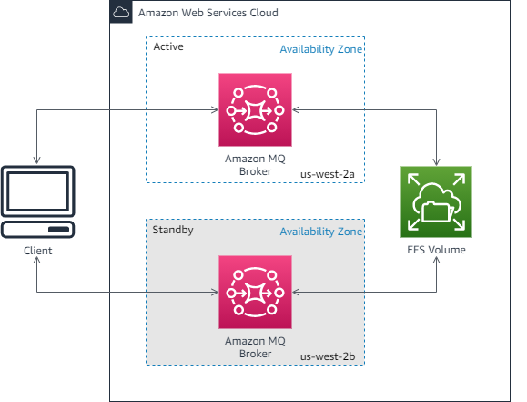
Amazon MQ: Broker as a Service

Slide 30
SQS & Amazon MQ Common Use Cases
Task Queues: Distribute tasks among multiple workers (e.g., image processing, video encoding).
Order Processing: Decouple order placement from fulfillment.
Event-Driven Architectures: Connect microservices asynchronously.
Buffering: Ingest high volumes of data to be processed later.
Legacy Application Integration (MQ): Migrate existing applications to the cloud without rewriting messaging logic.

Slide 31
SQS & Amazon MQ Best Practices & Considerations
Message Size Limits: Be aware of limits for both services.
Error Handling: Implement robust error handling and DLQs.
Monitoring: Use CloudWatch for queue depth, message counts, and consumer health.
Security: Use IAM policies for SQS access; manage network access for Amazon MQ brokers.
Choose the Right Service: SQS for simple, highly scalable queues; MQ for complex routing, open protocols, or lift-and-shift.

Slide 32
AWS Secrets Manager (Centralized Credential Handling)

Slide 33
AWS Secrets Manager: Securely Store & Rotate Credentials
What it is: A service that helps you protect access to your applications, services, and IT resources by rotating, managing, and retrieving database credentials, API keys, and other secrets throughout their lifecycle.
Purpose:
Eliminate hardcoded credentials in code.
Automate secret rotation, reducing the risk of compromised secrets.
Provide centralized management and auditing of secrets.
Integrate with other AWS services (RDS, Redshift, DocumentDB, Lambda).
Key Detail: Automates rotation of secrets.

Slide 34
Secret Lifecycle: Store, Retrieve, & Rotate
Secret Storage: Encrypts secrets at rest using AWS KMS.
Secret Retrieval: Applications retrieve secrets at runtime via API calls, eliminating hardcoding.
Automatic Rotation: Integrate with Lambda functions for automated rotation of database credentials.
Versioning: Maintains different versions of secrets.
Cross-Account Access: Share secrets securely across AWS accounts.

Slide 35
Protecting Your Credentials: Security & Compliance
KMS Integration: All secrets are encrypted with KMS CMKs.
IAM Policies: Control who can access and manage secrets.
Resource-Based Policies: Grant specific permissions on a secret.
CloudTrail: Logs all API calls for auditing secret access and modifications.
Integration with AWS services: Automated credential management for supported databases.

Slide 36
Where to Use Secrets Manager
Database Credentials: Manage passwords for RDS, Redshift, etc.
API Keys: Store and rotate API keys for third-party services.
Application Credentials: Store credentials for internal services.
Database Master User Passwords: Securely manage privileged access.
SSH Keys: Store and manage SSH keys for instances.

Slide 37
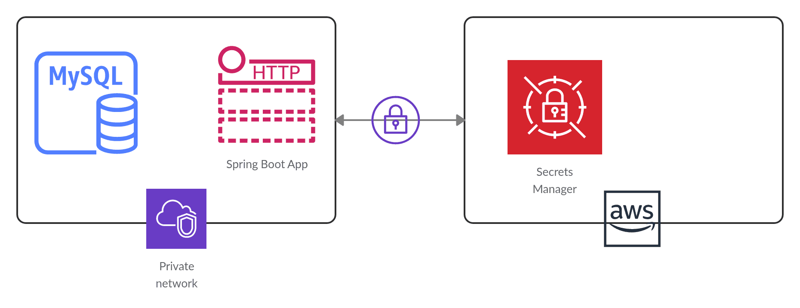
How Secrets Manager Works & Key Features

Slide 38
Implementing Robust Secret Management
Don't Hardcode! The primary rule.
Automate Rotation: Leverage built-in rotation for maximum security.
Least Privilege Access: Only grant necessary permissions to retrieve specific secrets.
Caching Secrets: Use client-side caching where appropriate to reduce API calls and latency.
Monitor Access: Regularly review CloudTrail logs for unusual secret access.
Separate Secrets per Environment: Isolate production secrets from dev/test.

Slide 39
AWS Web Application Firewall (WAF)

Slide 40
AWS WAF: Protecting Your Web Applications
What it is: A web application firewall that helps protect your web applications or APIs from common web exploits and bots that may affect availability, compromise security, or consume excessive resources.
Purpose:
Filter malicious traffic before it reaches your applications.
Protect against common attacks (SQL Injection, Cross-Site Scripting).
Control access based on IP, geo-location, HTTP headers.
Mitigate bot traffic.
Key Detail: Works at the application layer (Layer 7).

Slide 41
WAF Deployment: Protecting Your Edge
Web ACLs (Access Control Lists): Collections of rules that define how to inspect web requests.
Rules: Conditions that WAF evaluates (e.g., IP address, HTTP headers, URI strings).
Actions: Block, Allow, Count (for monitoring).
Integration with:
Amazon CloudFront (for global distribution)
Application Load Balancer (ALB)
Amazon API Gateway
AWS AppSync
Managed Rules: Pre-configured rulesets by AWS or third-party sellers.

Slide 42
Granular Control: Crafting Your WAF Rules
IP Set Rules: Block/allow specific IP addresses or ranges.
SQL Injection Rules: Detect and block SQL injection attempts.
XSS (Cross-Site Scripting) Rules: Detect and block XSS attacks.
Size Constraint Rules: Block requests based on size of parts (e.g., header, query string).
Regex Match Rules: Use regular expressions for complex pattern matching.
Managed Rule Groups:
AWS Managed Rule Groups: Common vulnerabilities, known bad IPs, bot control.
AWS Marketplace Managed Rule Groups: From security vendors.

Slide 43
Seeing Your Protections in Action
CloudWatch Metrics: Number of blocked/allowed requests, rule matches.
CloudWatch Logs (Full Logs): Detailed information about each request that WAF inspects.
AWS Firewall Manager: Centrally manage WAF rules across multiple accounts/resources.

Slide 44
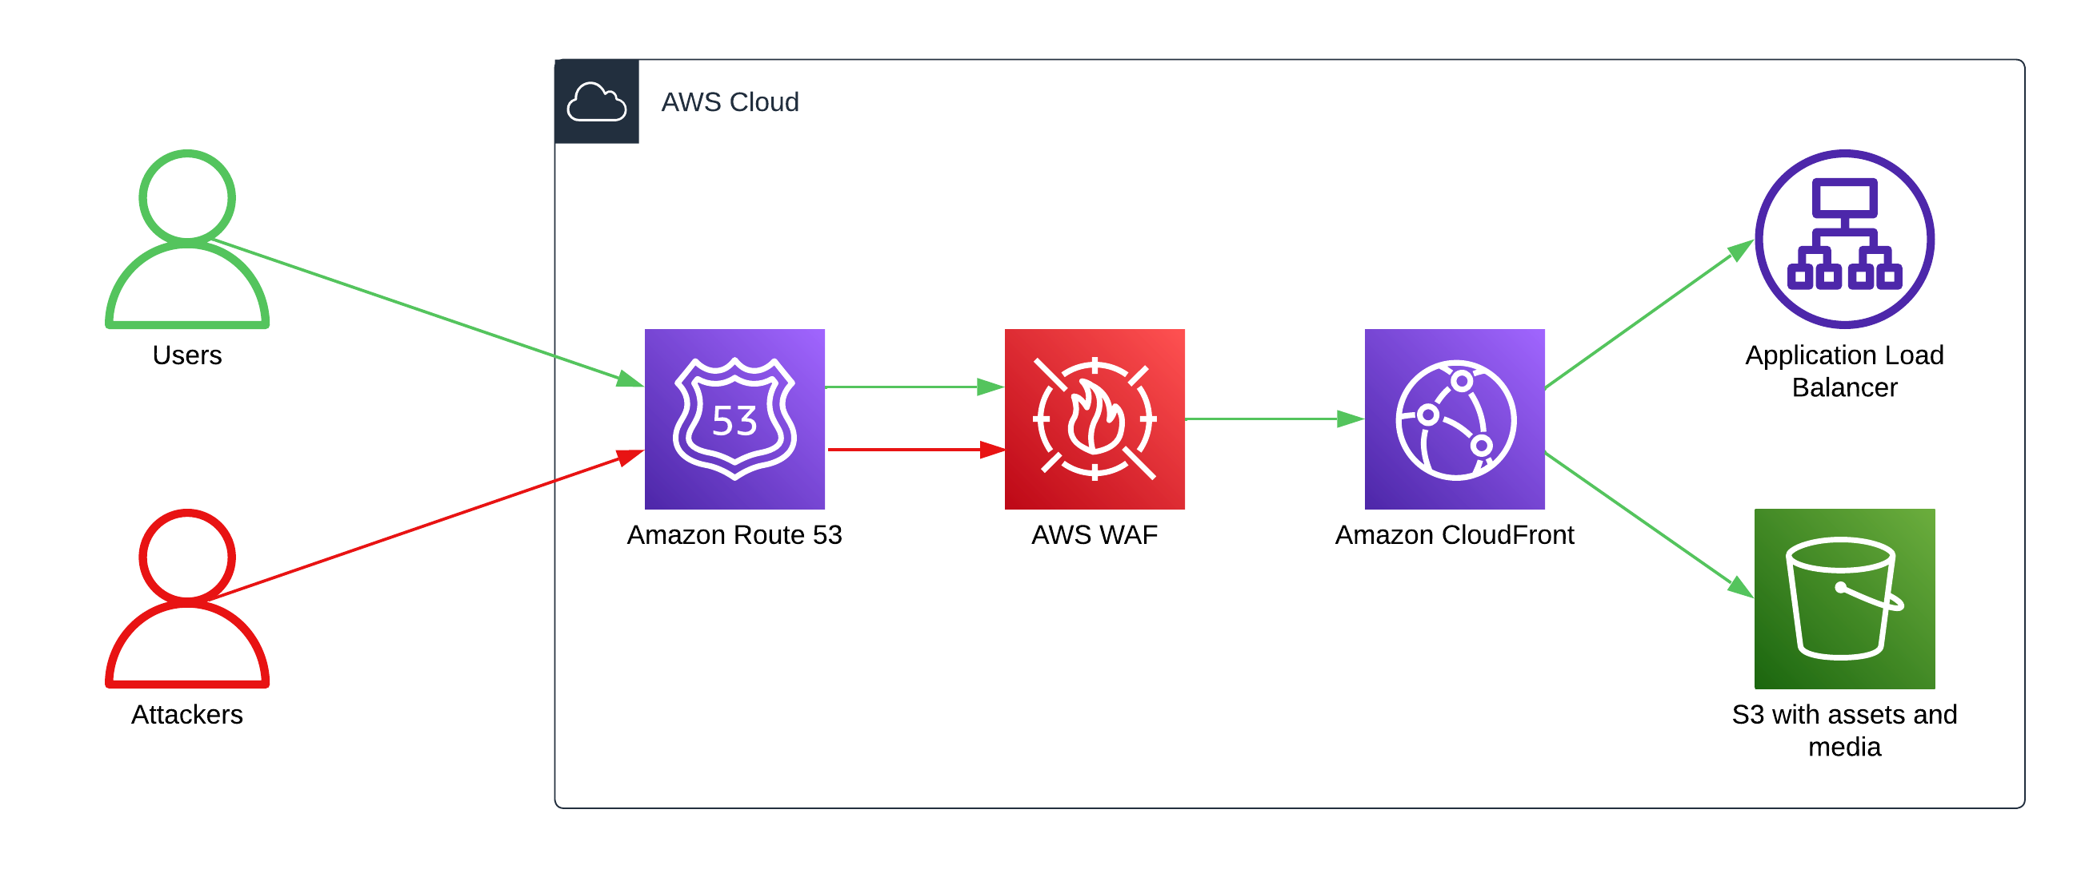
How WAF Works & Integration Points

Slide 45
Effective WAF Deployment & Management
Start with "Count" Action: Test rules in "count" mode before blocking to avoid false positives.
Combine Managed and Custom Rules: Leverage AWS/marketplace rules, then add specific custom rules.
Geo-Blocking: Block traffic from unwanted regions.
Rate-Based Rules: Mitigate DDoS attacks by limiting requests from suspicious IPs.
Regular Review: Update rules based on new threats and application changes.
WAF Logs: Analyze logs for insights into attack patterns.

Slide 46
AWS Systems Manager Parameter Store

Slide 47
AWS Systems Manager Parameter Store: Secure Configuration Management
What it is: A capability of AWS Systems Manager that provides secure, hierarchical storage for configuration data management and secrets management.
Purpose:
Store configuration data (e.g., database strings, API keys, feature flags) separately from code.
Centralize access to parameters for applications and scripts.
Integrate with other AWS services for dynamic configurations.
Support versioning and change notifications.
Key Detail: Free to use (within limits), supports plain text and encrypted parameters.

Slide 48
Storing & Retrieving Parameters
Parameters: Key-value pairs.
Hierarchy: Organize parameters using paths (e.g., /prod/app1/db_url).
Parameter Types:
String: Plain text.
StringList: Comma-separated values.
SecureString: Encrypted using KMS.
Versioning: Track changes to parameters.
Notifications: Integrate with SNS for changes.

Slide 49
Parameter Store vs. Secrets Manager: Choosing the Right Tool
Parameter Store (SecureString):
Good for non-rotatable secrets, configuration data, feature flags.
Manual or custom rotation.
Free (within limits).
Secrets Manager:
Designed for automatically rotatable credentials (e.g., database passwords).
Built-in integration for automated rotation.
Cost associated per secret and per API call.
Rule of Thumb: If it needs automated rotation, use Secrets Manager. If it's configuration or a secret that rarely changes/doesn't need automated rotation, use Parameter Store.

Slide 50
Dynamic Configuration Across Your Stack
Lambda Functions: Retrieve environment variables at runtime.
EC2 Instances: Use in user data scripts or via SSM Agent.
Containerized Applications: Inject parameters into ECS/EKS tasks.
CI/CD Pipelines: Store pipeline variables or sensitive build parameters.
Feature Flags: Store feature toggles that can be updated dynamically.

Slide 51
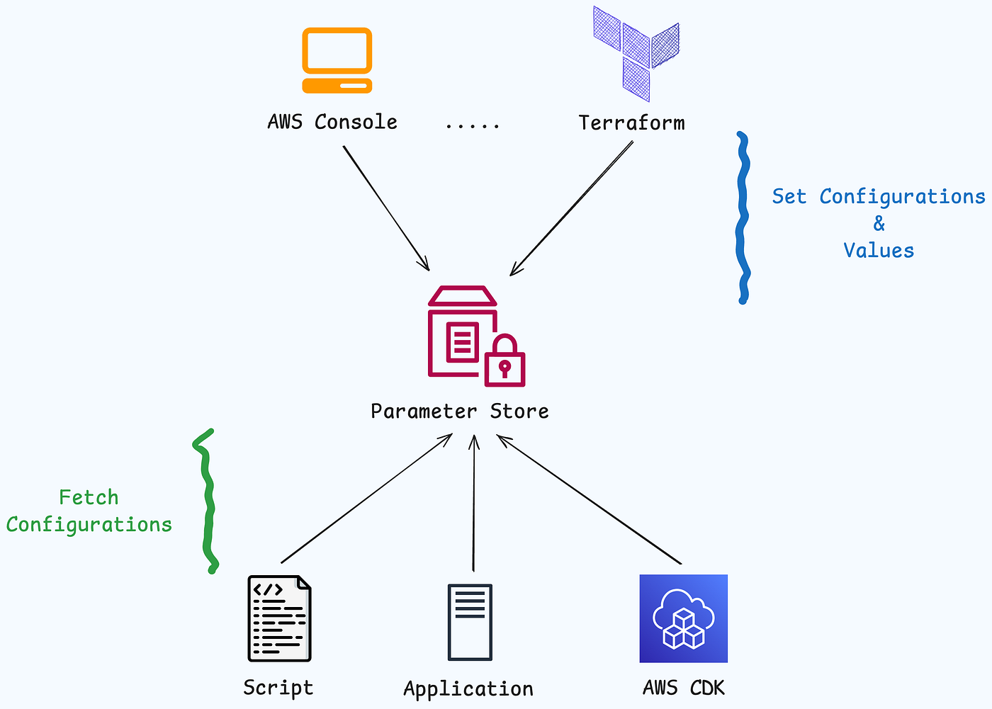
How Parameter Store Works & Parameter Types

Slide 52
Efficient & Secure Parameter Management
Use Hierarchies: Organize parameters logically for clarity and access control.
Encrypt Sensitive Data (SecureString): Always use SecureString for credentials.
Least Privilege: Grant specific IAM permissions to access only needed parameters.
Version Control: Leverage automatic versioning for rollbacks.
Caching: Implement caching in your applications to reduce API calls if reading frequently.
Monitor Usage: Track access patterns and changes via CloudTrail.

Slide 53
CONCLUSION

Slide 54
Building Resilient & Secure Architectures
AWS services provide foundational building blocks for modern cloud applications.
Understanding the purpose and features of each service is crucial for effective design.
Security (IAM, KMS, WAF, Secrets Manager) is paramount and integrated.
Decoupling with messaging (SQS, MQ) enhances scalability and resilience.
Centralized configuration (Parameter Store) improves manageability.
Continuous learning and hands-on experience are key!

Slide 55
Questions & Discussion

Slide 56
THANK YOU

